Slide 1
ELECTRONIC PASSPORT

Slide 2
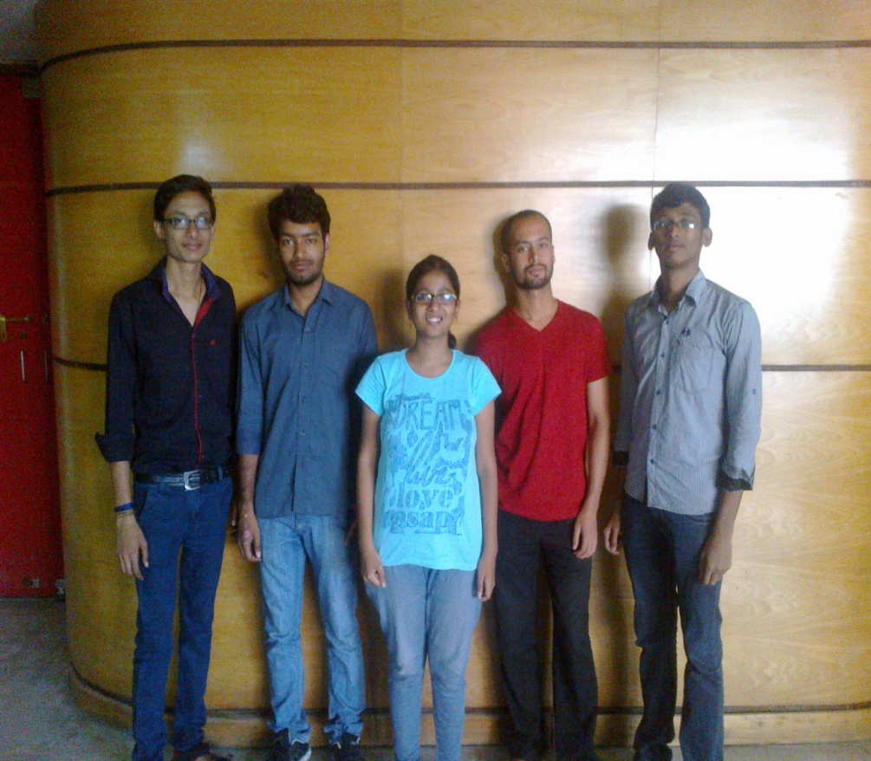
THE IMPROVISERS
Komal
Hareesh
Pawan
PrasannJit
Shivam

Slide 3
TOP 3 Ideas
Electronic Passport
Air-conditioned Shoe
Power Exchanging Card

Slide 4
Problem Statement
Citizens who are travelling by airways need
a better substitute of passports because it can provide more security and convenience.

Slide 5
Solution…..
Issuing the electronic ID cards which are not possible to forgery and not possible to change the details and easy to update.

Slide 6
What this ID card contains?
This ID card contains
Personal Information.
Identification Info.(Finger prints/Eye Retina)
Boarding/Travel Information.
Legal Records.

Slide 7
Impacts
Better Security
Easy to Carry
Easy to Update Information
Avoiding the Forgery and Fake
Less Time Consuming

Slide 8
Six Thinking Hats
White Hat
When Malaysian airlines flight 370 disappeared, one of the many serious issues raised was that two of the passengers were travelling with fake passports.

Slide 9
Yellow Hat
This ID card contains Personal Information, Identification Info.(Finger prints/Eye Retina) and Boarding/Travel Information, Legal Records.
Thus, faking and forgery of the card will not be possible.
Passengers can save time during passport checks.
It is easier to carry around.
Governments and airlines will be benefitted.

Slide 10
Green Hat
It can have a chip to store any information.
It can carry your bank account details.
Red Hat
The consideration and implementation of the idea might be a difficult process.

Slide 11
Black Hat
Technical errors.
The idea will take a lot of time to materialize.
Initial cost will be much higher.
Need of new machinery for scanning the cards.

Slide 12
Blue Hat
Electronic Passport will be useful in stopping the forged passports.
Legal issues about each holder can be updated easily.

Slide 13
What help do we need to implement this idea?
We need the help of IT sector companies for storing the information(chip).
We have to convince the government authorities to implement.

Slide 14
THANK YOU

